Slide 1
Fabric Data Factory
Mathias Halkjær
Principal Architect, Fellowmind

Slide 2






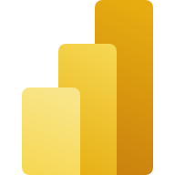


Microsoft Fabric
Data Factory
Synapse Data Engineering
Synapse Data Warehouse
Synapse Data Science
Synapse Real-Time Analytics
Power BI
Data Activator (coming soon)
OneLake
Notes:
Unified Analytics Platform
Lake Centric and Open
Empower every Office user
Pervasive security and governance

Slide 3


Data Factory
Empower data engineers and data warehouse engineers to fetch data from any data source effectively and flexible.
By combining the low-code visual transformation capabilities in the upgraded dataflows with the scalability of data pipelines, Data Factory in Microsoft Fabric offers us the most powerful, wide-ranging and flexible data integration toolbox to date.
Moreover, the powerful orchestration capabilities of pipelines turns Data Factory into the control center of how your data flows.
TOOLS
DATAFLOW (GEN2)
DATA PIPELINE

Slide 4
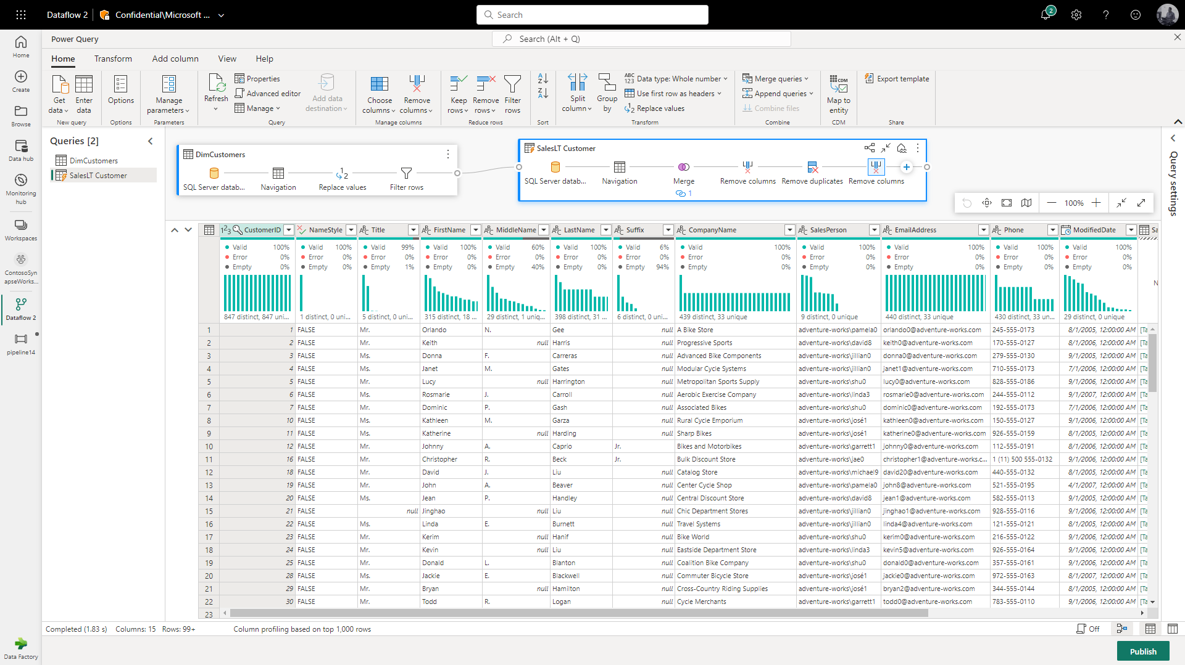
Code-free ETL with Dataflows
DATAFLOW (GEN2)
Redesigned as to utilize the powerful Spark engine, Dataflows have undergone a huge upgrade in its 2. generation.
Dataflows now offer the following:
Spark-powered capabilities
Visual no-code visual transformation
Flexible data destinations (SQL, Lakehouse and Data Explorer)
Use dataflow easily import data from 100s of sources and as easily write to several destinations.

Slide 5

Ingest vs. load
DATA PIPELINE
DATAFLOW
DATASET
Ingestion, as performed in Azure Data Factory, refers to acquiring and importing data in its raw form from diverse sources. It's systematic, scheduled, and supports large volumes.
Loading, as seen in datasets – and sometimes in dataflows, is the simpler process of inputting data into a specific system or database for immediate analysis, often without sophisticated preparation.
While this may be convenient, it can lead to unsystematic ETL (Extract, Transform, Load) processes and might limit data quality and comprehensive insights

Slide 6
Dynamic Pipelines
DATA PIPELINE
In Power Query, we usually work with data that doesn't change much. But the reality is that data is often changing and coming from many places—With dynamic pipelines, we can keep up with these changes.
These pipelines can easily and automatically adjust to new data sources, change their actions based on the type of data, or send data to different places as needed.
This means we can do more with our data, and we can do it more easily and efficiently.

Slide 7
Meta-data framework
DATA PIPELINE
A top-notch metadata framework is the secret sauce behind every smooth-running dynamic data pipeline. It keeps track of data sources, table names, and where and how to store the data. This makes it simple and flexible to tweak or expand your data integration setup, offering an efficient and user-friendly solution.
Suggestions for a meta-data framework:
Azure SQL
Data Lake Table Storage
JSON config files

Slide 8
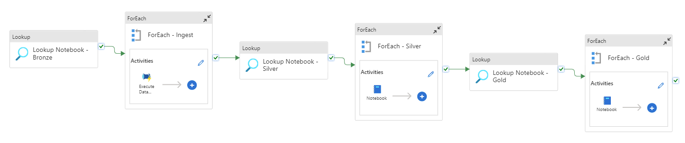
Orchestration
DATA PIPELINE
Orchestration in Microsoft Fabric is essential for managing complex data workflows.
It coordinates tasks, monitors dependencies, and handles failures, ensuring seamless data flow. This process empowers the data platform by minimizing errors, optimizing resource utilization, and enabling scalability.
In any data platform, orchestration ensures smooth data movement and processing, enabling efficient analytics
and business insights.
Example orchestration pipeline

Slide 9
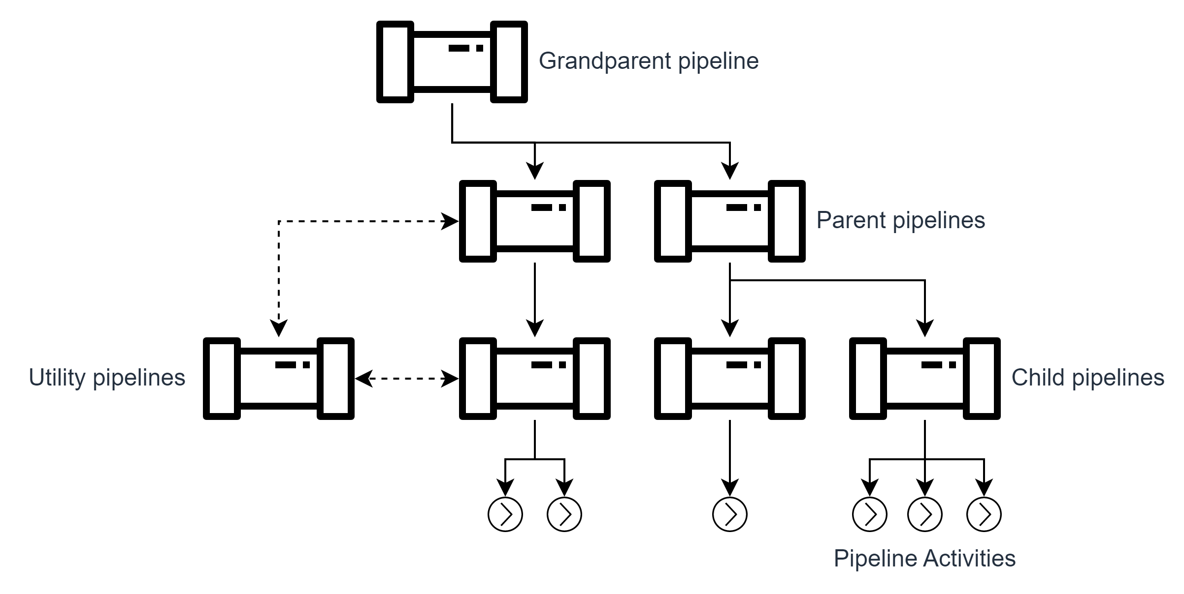
Hierarchy of pipelines
DATA PIPELINE
Pipelines can trigger other pipelines.
A very flexible capability that quickly turn messy if not structured properly.
By structuring pipelines in a managed hierarchy of pipelines
it is easier to manage, troubleshoot and govern how data flows through the entire organization.

Slide 10
Thank you

Slide 11
Master slide title

Slide 12
Agenda

Slide 13
Contents

Slide 14
Section title one

Slide 15
Section title two

Slide 16
Section title three

Slide 17
Title

Slide 18
Section title five

Slide 19
Microsoft Fabric
Microsoft Fabric

Slide 20
Microsoft Fabric / Section title

Slide 21
Microsoft Fabric / Section title

Slide 22
Page title

Slide 23
Page title

Slide 24
Page title

Slide 25
Page title

Slide 26
Page title

Slide 27
Page title

Slide 28
Next steps

Slide 29
Next steps

Slide 30
Get started today

Slide 31
Appendix

Slide 32
Thank you

Slide 33
Thank you

Slide 34


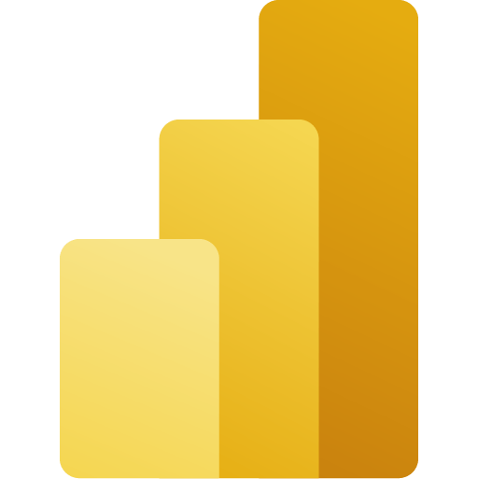






Microsoft Fabric Experience icon library
Service icons are not logos. We do not use product and service icons to represent Fabric in marketing communications. These icons are only used in product UX and diagrams that illustrate the functional aspects of the product.
Data Factory
OneLake
Power BI
Synapse Data Engineering
Synapse Data Science
PLACE
HOLDER
Synapse Data Warehouse
Synapse Real Time Analytics
Synapse
Data Activator
Fabric

